Slide 1
Servlets
‹#›
Outline 24.1 Introduction 24.2 Servlet Overview and Architecture 24.2.1 Interface Servlet and the Servlet Life Cycle 24.2.2 HttpServlet Class 24.2.3 HttpServletRequest Interface 24.2.4 HttpServletResponse Interface 24.3 Handling HTTP get Requests 24.3.2 Deploying a Web Application 24.4 Handling HTTP get Requests Containing Data 24.5 Handling HTTP post Requests 24.6 Redirecting Requests to Other Resources 24.7 Multi-Tier Applications: Using JDBC from a Servlet

Slide 2
24.1 Introduction
‹#›
Java networking capabilities (develop Internet-based and Web-based applications)
Fundamental networking capabilities -- Package java.net
Socket-based communications (used for text)
Packet-based communications (used for audio/video)
Client-server relationship
Client requests action to be performed
Server performs action and responds to client
Servlet extends functionality of (Web) server

Slide 3
24.1 Introduction
‹#›
Java networking capabilities
Servlets and Java Server Pages (JSP)
Request-response model
Packages javax.servlet (servlets)
javax.servlet.http (servlets)
javax.servlet.jsp (JSPs)
javax.servlet.tagext (JSPs)
Servlets – Web-based solutions
Secure access to Website
Interact with databases
Dynamically generate custom HTML documents
JSPs provide some of same functionality without getting into details of servlets

Slide 4
24.2 Servlet Overview and Architecture
‹#›
Servlets used when small portion of content sent to client is static
Java Server Pages (JSPs) used when only small portion of content set to client is dynamic, most is static
HyperText Transfer Protocol (HTTP)
Uniform Resource Locator (URL)
Servlets communicate between clients and servers using HTTP

Slide 5
24.2 Servlet Overview and Architecture
‹#›
Client sends HTTP request
Servlet container receives request, directs it to the appropriate servlet
Servlet does processing (including interacting with databases)
Servlet returns results to client in form of HTML document

Slide 6
24.2.1 Interface Servlet and the Servlet Life Cycle
‹#›
Interface Servlet
All servlets must implement this interface
All methods of interface Servlet are invoked by servlet container
Servlet life cycle
Servlet container invokes the servlet’s init method before servlet can respond to first request
Servlet’s service method handles requests (receives, processes, sends response to client)
Servlet’s service method called once per request, runs in a Thread
Servlet’s destroy method releases servlet resources when the servlet container terminates the servlet

Slide 7
24.2.1 Interface Servlet and the Servlet Life Cycle
‹#›
Servlet implementation (two abstract classes implement Servlet interface)
GenericServlet (javax.servlet)
HttpServlet (javax.servlet.http)
service method
ServletRequest object is data from client
ServletResponse object is data to the client

Slide 8
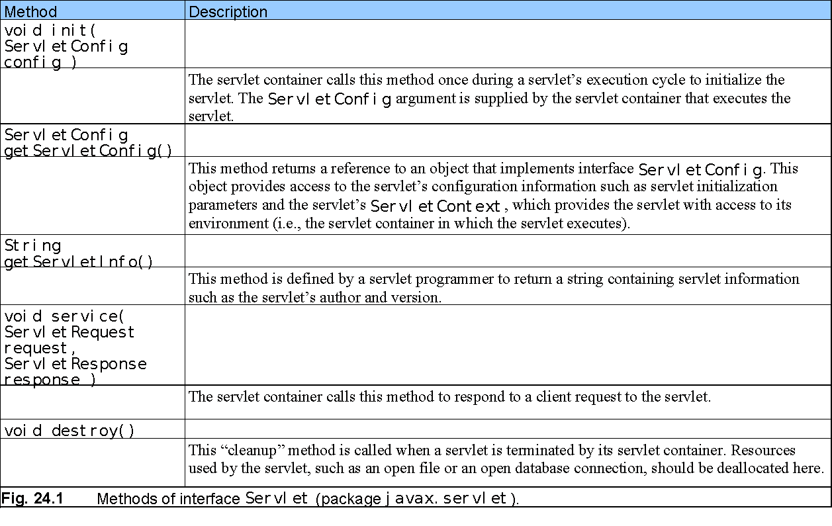
24.2.1 Interface Servlet and the Servlet Life Cycle (Cont.)
‹#›

Slide 9
24.2.2 HttpServlet Class
‹#›
Web-based servlets typically extend class HttpServlet
HttpServlet overrides method service
Two most common HTTP request types
get requests (data rides on URL)
post requests (data sent in a file)
Method doGet responds to get requests
Method doPost responds to post requests

Slide 10
24.2.2 HttpServlet Class
‹#›
HttpServletRequest and HttpServletResponse objects enable interaction between client and server

Slide 11
24.2.3 HttpServletRequest Interface
‹#›
Web server
creates an HttpServletRequest object
passes it to the servlet’s service method (that is, doGet or doPost)
HttpServletRequest object contains the request from the client

Slide 12
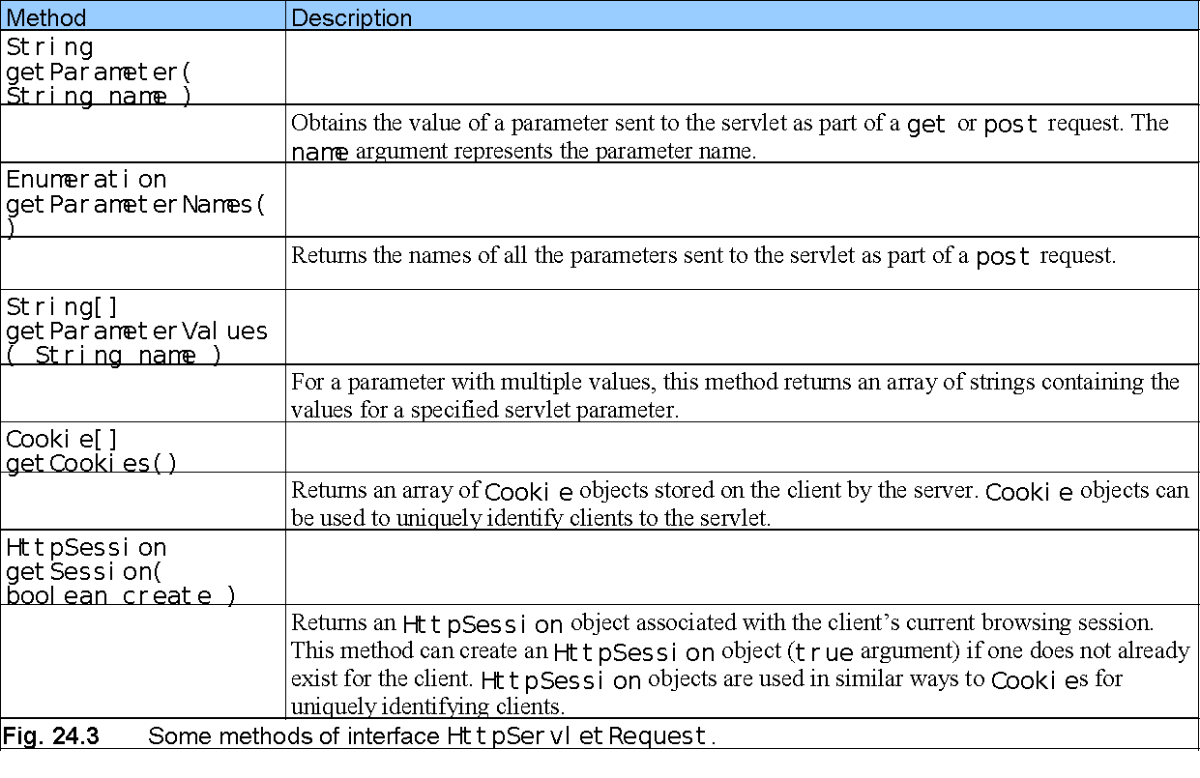
24.2.3 HttpServletRequest Interface (Cont.)
‹#›

Slide 13
24.2.4 HttpServletResponse Interface
‹#›
Web server
creates an HttpServletResponse object
passes it to the servlet’s service method (that is, doGet or doPost)

Slide 14
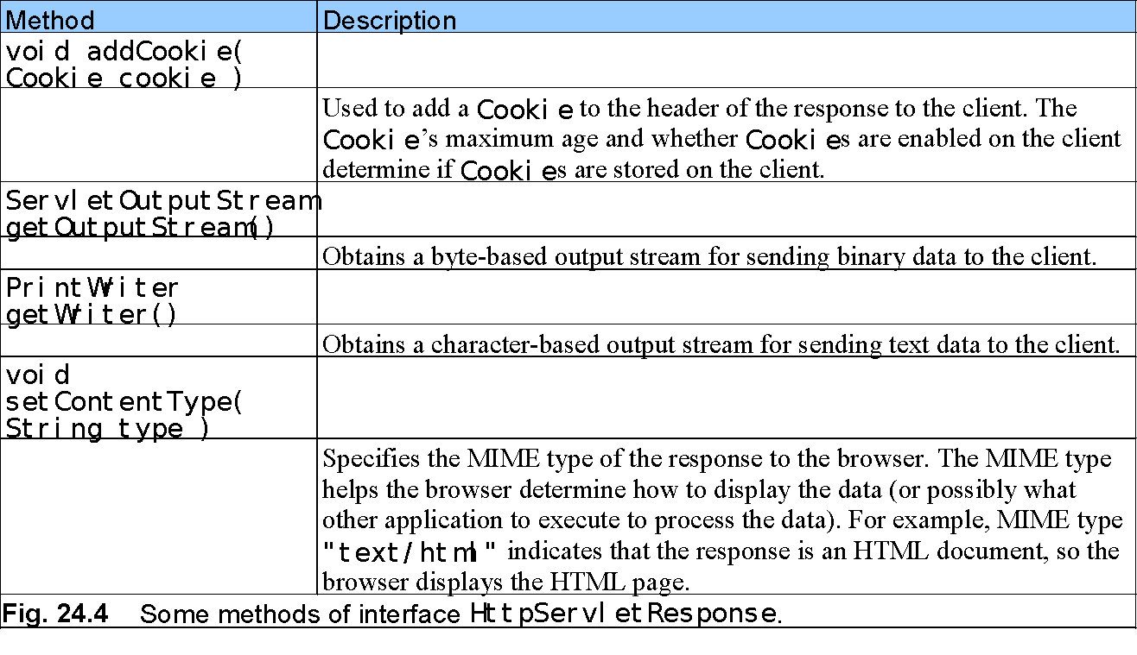
24.2.4 HttpServletResponse Interface (Cont.)
‹#›

Slide 15
24.3 Handling HTTP get Requests
‹#›
get request
May send data on the URL; this example does not
Example: WelcomeServlet
a servlet handles HTTP get requests
response.setContentType("text/html") provides the browser with Multipurpose Internet Mail Extension (MIME) type

Slide 16
WelcomeServlet
‹#›
1 // Fig. 24.5: WelcomeServlet.java
2 // A simple servlet to process get requests.
3
4 import javax.servlet.*;
5 import javax.servlet.http.*;
6 import java.io.*;
7
8 public class WelcomeServlet extends HttpServlet {
9
10 // process "get" requests from clients
11 protected void doGet( HttpServletRequest request,
12 HttpServletResponse response )
13 throws ServletException, IOException
14 {
15 response.setContentType( "text/html" );
16 PrintWriter out = response.getWriter();
17
18 // send XHTML page to client
19
20 // start XHTML document
21 out.println( "<?xml version = \"1.0\"?>" );
22
23 out.println( "<!DOCTYPE html PUBLIC \"-//W3C//DTD " +
24 "XHTML 1.0 Strict//EN\" \"http://www.w3.org" +
25 "/TR/xhtml1/DTD/xhtml1-strict.dtd\">" );
26
Import the javax.servlet and javax.servlet.http packages.
Extends HttpServlet to handle HTTP get requests and HTTP post requests.
Override method doGet to provide custom get request processing.
Uses the response object’s setContentType method to specify the content type of the data to be sent as the response to the client.
Uses the response object’s getWriter method to obtain a reference to the PrintWriter object that enables the servlet to send content to the client.
Create the XHTML document by writing strings with the out object’s println method.

Slide 17
WelcomeServlet
‹#›
27 out.println( "<html xmlns = \"http://www.w3.org/1999/xhtml\">" );
28
29 // head section of document
30 out.println( "<head>" );
31 out.println( "<title>A Simple Servlet Example</title>" );
32 out.println( "</head>" );
33
34 // body section of document
35 out.println( "<body>" );
36 out.println( "<h1>Welcome to Servlets!</h1>" );
37 out.println( "</body>" );
38
39 // end XHTML document
40 out.println( "</html>" );
41 out.close(); // close stream to complete the page
42 }
43 }
Closes the output stream, flushes the output buffer and sends the information to the client.

Slide 18
WelcomeServlet.html
‹#›
1 <?xml version = "1.0"?>
2 <!DOCTYPE html PUBLIC "-//W3C//DTD XHTML 1.0 Strict//EN"
3 "http://www.w3.org/TR/xhtml1/DTD/xhtml1-strict.dtd">
4
5 <!-- Fig. 24.6: WelcomeServlet.html -->
6
7 <html xmlns = "http://www.w3.org/1999/xhtml">
8 <head>
9 <title>Handling an HTTP Get Request</title>
10 </head>
11
12 <body>
13 <form action = "/jhtp5/welcome1" method = "get">
14
15 <p><label>Click the button to invoke the servlet
16 <input type = "submit" value = "Get HTML Document" />
17 </label></p>
18
19 </form>
20 </body>
21 </html>

Slide 19
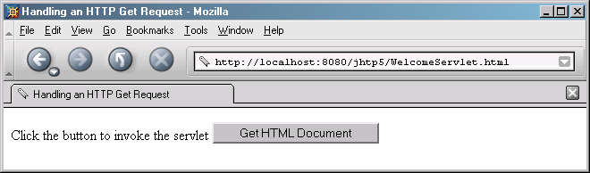
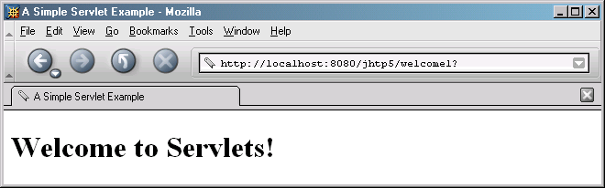
Program output
‹#›

Slide 20
24.3.2 Deploying a Web Application
‹#›
Web applications
JSPs, servlets, and their supporting files
Deploying a Web application
Deployment descriptor
web.xml

Slide 21
web.xml
‹#›
1 <!DOCTYPE web-app PUBLIC \
2 "-//Sun Microsystems, Inc.//DTD Web Application 2.2//EN"
3 "http://java.sun.com/j2ee/dtds/web-app_2_2.dtd">
4
5 <web-app>
6
7 <!-- General description of your Web application -->
8 <display-name>
9 Java How to Program JSP
10 and Servlet Chapter Examples
11 </display-name>
12
13 <description>
14 This is the Web application in which we
15 demonstrate our JSP and Servlet examples.
16 </description>
17
18 <!-- Servlet definitions -->
19 <servlet>
20 <servlet-name>welcome1</servlet-name>
21
22 <description>
23 A simple servlet that handles an HTTP get request.
24 </description>
25
Element web-app defines the configuration of each servlet in the Web application and the servlet mapping for each servlet.
Element display-name specifies a name that can be displayed to the administrator of the server on which the Web application is installed.
Element description specifies a description of the Web application that might be displayed to the administrator of the server.
Element servlet describes a servlet.
Element servlet-name is the name for the servlet.
Element description specifies a description for this particular servlet.

Slide 22
web.xml Lines 26-28 Lines 32-35
‹#›
Element servlet-class specifies compiled servlet’s fully qualified class name.
26 <servlet-class>
27 WelcomeServlet
28 </servlet-class>
29 </servlet>
30
31 <!-- Servlet mappings -->
32 <servlet-mapping>
33 <servlet-name>welcome1</servlet-name>
34 <url-pattern>/welcome1</url-pattern>
35 </servlet-mapping>
36
37 </web-app>
Element servlet-mapping specifies servlet-name and url-pattern elements.

Slide 23
24.4 Handling HTTP get Requests Containing Data
‹#›
Servlet WelcomeServlet2
Responds to a get request that contains data
Parameters passed as name/value pairs on the URL (http://.../welcome2?firstname=Paul)
String firstName = request.getParameter("firstname");
retrieves the string “Paul”
retrieves null if no parameter has the name firstname
parameters typically come from HTML FORMs
servlet is called when SUBMIT button is clicked
Multiple parameters separated by &’s (http://.../welcome2?firstname=Paul&lastname=Davis&idnum=22471)

Slide 24
WelcomeServlet2 responds to a get request that contains data. Line 15
‹#›
1 // Fig. 24.11: WelcomeServlet2.java
2 // Processing HTTP get requests containing data.
3
4 import javax.servlet.*;
5 import javax.servlet.http.*;
6 import java.io.*;
7
8 public class WelcomeServlet2 extends HttpServlet {
9
10 // process "get" request from client
11 protected void doGet( HttpServletRequest request,
12 HttpServletResponse response )
13 throws ServletException, IOException
14 {
15 String firstName = request.getParameter( "firstname" );
16
17 response.setContentType( "text/html" );
18 PrintWriter out = response.getWriter();
19
20 // send XHTML document to client
21
22 // start XHTML document
23 out.println( "<?xml version = \"1.0\"?>" );
24
The request object’s getParameter method receives the parameter name and returns the corresponding String value.

Slide 25
WelcomeServlet2 responds to a get request that contains data. Line 39
‹#›
25 out.println( "<!DOCTYPE html PUBLIC \"-//W3C//DTD " +
26 "XHTML 1.0 Strict//EN\" \"http://www.w3.org" +
27 "/TR/xhtml1/DTD/xhtml1-strict.dtd\">" );
28
29 out.println( "<html xmlns = \"http://www.w3.org/1999/xhtml\">" );
30
31 // head section of document
32 out.println( "<head>" );
33 out.println(
34 "<title>Processing get requests with data</title>" );
35 out.println( "</head>" );
36
37 // body section of document
38 out.println( "<body>" );
39 out.println( "<h1>Hello " + firstName + ",<br />" );
40 out.println( "Welcome to Servlets!</h1>" );
41 out.println( "</body>" );
42
43 // end XHTML document
44 out.println( "</html>" );
45 out.close(); // close stream to complete the page
46 }
47 }
Uses the result of line 16 as part of the response to the client.

Slide 26
HTML document in which the form’s action invokes WelcomeServlet2 through the alias welcome2 specified in web.xml. Line 17
‹#›
1 <?xml version = "1.0"?>
2 <!DOCTYPE html PUBLIC "-//W3C//DTD XHTML 1.0 Strict//EN"
3 "http://www.w3.org/TR/xhtml1/DTD/xhtml1-strict.dtd">
4
5 <!-- Fig. 24.12: WelcomeServlet2.html -->
6
7 <html xmlns = "http://www.w3.org/1999/xhtml">
8 <head>
9 <title>Processing get requests with data</title>
10 </head>
11
12 <body>
13 <form action = "/jhtp5/welcome2" method = "get">
14
15 <p><label>
16 Type your first name and press the Submit button
17 <br /><input type = "text" name = "firstname" />
18 <input type = "submit" value = "Submit" />
19 </p></label>
20
21 </form>
22 </body>
23 </html>
Get the first name from the user.

Slide 27
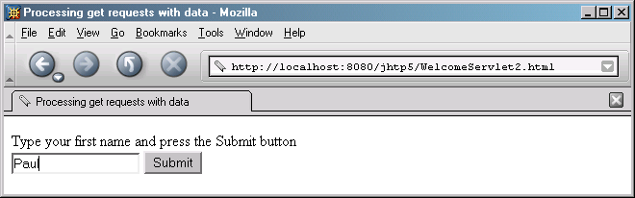
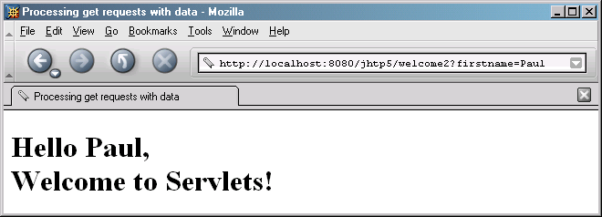
HTML document in which the form’s action invokes WelcomeServlet2 through the alias welcome2 specified in web.xml. Program output
‹#›

Slide 28
24.5 Handling HTTP post Requests
‹#›
HTTP post request
Post data from an HTML form to a server-side form handler using a file
Browsers usually do NOT cache post requests
Search engines usually use “get” because just a little data
Browsers usually cache get requests
Servlet WelcomeServlet3
Responds to a post request that contains data

Slide 29
WelcomeServlet3 responds to a post request that contains data. Lines 11-46
‹#›
1 // Fig. 24.14: WelcomeServlet3.java
2 // Processing post requests containing data.
3
4 import javax.servlet.*;
5 import javax.servlet.http.*;
6 import java.io.*;
7
8 public class WelcomeServlet3 extends HttpServlet {
9
10 // process "post" request from client
11 protected void doPost( HttpServletRequest request,
12 HttpServletResponse response )
13 throws ServletException, IOException
14 {
15 String firstName = request.getParameter( "firstname" );
16
17 response.setContentType( "text/html" );
18 PrintWriter out = response.getWriter();
19
20 // send XHTML page to client
21
22 // start XHTML document
23 out.println( "<?xml version = \"1.0\"?>" );
24
Declare a doPost method to responds to post requests.

Slide 30
WelcomeServlet3.java
‹#›
25 out.println( "<!DOCTYPE html PUBLIC \"-//W3C//DTD " +
26 "XHTML 1.0 Strict//EN\" \"http://www.w3.org" +
27 "/TR/xhtml1/DTD/xhtml1-strict.dtd\">" );
28
29 out.println( "<html xmlns = \"http://www.w3.org/1999/xhtml\">" );
30
31 // head section of document
32 out.println( "<head>" );
33 out.println(
34 "<title>Processing post requests with data</title>" );
35 out.println( "</head>" );
36
37 // body section of document
38 out.println( "<body>" );
39 out.println( "<h1>Hello " + firstName + ",<br />" );
40 out.println( "Welcome to Servlets!</h1>" );
41 out.println( "</body>" );
42
43 // end XHTML document
44 out.println( "</html>" );
45 out.close(); // close stream to complete the page
46 }
47 }

Slide 31
HTML document in which the form’s action invokes WelcomeServlet3 through the alias welcome3 specified in web.xml. Lines 13-21
‹#›
1 <?xml version = "1.0"?>
2 <!DOCTYPE html PUBLIC "-//W3C//DTD XHTML 1.0 Strict//EN"
3 "http://www.w3.org/TR/xhtml1/DTD/xhtml1-strict.dtd">
4
5 <!-- Fig. 24.15: WelcomeServlet3.html -->
6
7 <html xmlns = "http://www.w3.org/1999/xhtml">
8 <head>
9 <title>Handling an HTTP Post Request with Data</title>
10 </head>
11
12 <body>
13 <form action = "/jhtp5/welcome3" method = "post">
14
15 <p><label>
16 Type your first name and press the Submit button
17 <br /><input type = "text" name = "firstname" />
18 <input type = "submit" value = "Submit" />
19 </label></p>
20
21 </form>
22 </body>
23 </html>
Provide a form in which the user can input a name in the text input element firstname, then click the Submit button to invoke WelcomeServlet3.

Slide 32
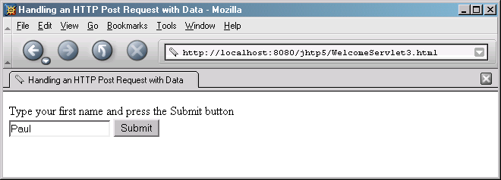
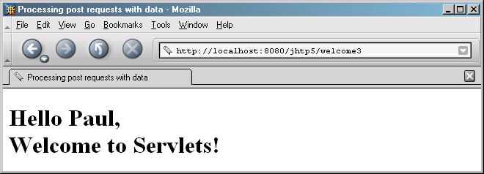
HTML document in which the form’s action invokes WelcomeServlet3 through the alias welcome3 specified in web.xml. Program output
‹#›

Slide 33
24.6 Redirecting Requests to Other Resources
‹#›
Servlet RedirectServlet
Redirects the request to a different resource
Why not just have links to those resources?
Could determine browser type and choose link accordingly
Could add parameters before redirecting (those sent originally are included automatically)
response.sendRedirect(URL);
redirects to that URL
immediately terminates current program
Use relative paths whenever possible to make Website portable

Slide 34
RedirectServletredirecting requests to other resources. Line 15 Lines 19-23 Line 20 Line 23 Lines 29-56
‹#›
1 // Fig. 24.17: RedirectServlet.java
2 // Redirecting a user to a different Web page.
3
4 import javax.servlet.*;
5 import javax.servlet.http.*;
6 import java.io.*;
7
8 public class RedirectServlet extends HttpServlet {
9
10 // process "get" request from client
11 protected void doGet( HttpServletRequest request,
12 HttpServletResponse response )
13 throws ServletException, IOException
14 {
15 String location = request.getParameter( "page" );
16
17 if ( location != null )
18
19 if ( location.equals( "deitel" ) )
20 response.sendRedirect( "http://www.deitel.com" );
21 else
22 if ( location.equals( "welcome1" ) )
23 response.sendRedirect( "welcome1" );
24
Obtains the page parameter from the request.
Determine if the value is either “deitel” or “welcome1”
Redirects the request to www.deitel.com.
Redirects the request to the servlet WelcomeServlet.

Slide 35
RedirectServletredirecting requests to other resources. Lines 28-55
‹#›
25 // code that executes only if this servlet
26 // does not redirect the user to another page
27
28 response.setContentType( "text/html" );
29 PrintWriter out = response.getWriter();
30
31 // start XHTML document
32 out.println( "<?xml version = \"1.0\"?>" );
33
34 out.println( "<!DOCTYPE html PUBLIC \"-//W3C//DTD " +
35 "XHTML 1.0 Strict//EN\" \"http://www.w3.org" +
36 "/TR/xhtml1/DTD/xhtml1-strict.dtd\">" );
37
38 out.println(
39 "<html xmlns = \"http://www.w3.org/1999/xhtml\">" );
40
41 // head section of document
42 out.println( "<head>" );
43 out.println( "<title>Invalid page</title>" );
44 out.println( "</head>" );
45
46 // body section of document
47 out.println( "<body>" );
48 out.println( "<h1>Invalid page requested</h1>" );
Output a Web page indicating that an invalid request was made if method sendRedirect is not called.

Slide 36
RedirectServletredirecting requests to other resources.
‹#›
49 out.println( "<p><a href = " +
50 "\"servlets/RedirectServlet.html\">" );
51 out.println( "Click here to choose again</a></p>" );
52 out.println( "</body>" );
53
54 // end XHTML document
55 out.println( "</html>" );
56 out.close(); // close stream to complete the page
57 }
58 }

Slide 37
RedirectServlet.html document to demonstrate redirecting requests to other resources. Lines 15-16 Lines 17-18
‹#›
1 <?xml version = "1.0"?>
2 <!DOCTYPE html PUBLIC "-//W3C//DTD XHTML 1.0 Strict//EN"
3 "http://www.w3.org/TR/xhtml1/DTD/xhtml1-strict.dtd">
4
5 <!-- Fig. 24.18: RedirectServlet.html -->
6
7 <html xmlns = "http://www.w3.org/1999/xhtml">
8 <head>
9 <title>Redirecting a Request to Another Site</title>
10 </head>
11
12 <body>
13 <p>Click a link to be redirected to the appropriate page</p>
14 <p>
15 <a href = "/jhtp5/redirect?page=deitel">
16 www.deitel.com</a><br />
17 <a href = "/jhtp5/redirect?page=welcome1">
18 Welcome servlet</a>
19 </p>
20 </body>
21 </html>
Provide hyperlinks that allow the user to invoke the servlet RedirectServlet.

Slide 38
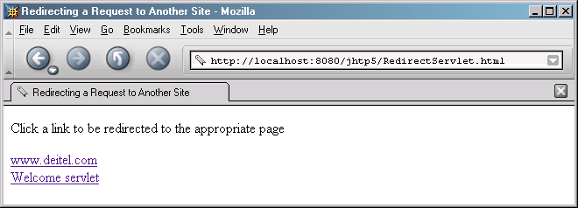
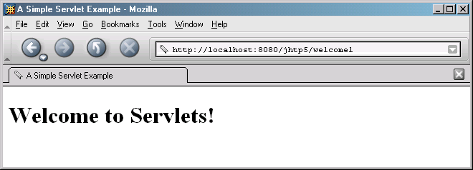
RedirectServlet.html document to demonstrate redirecting requests to other resources. Program output
‹#›

